Slide 1
Talent Management system
Your one click pitch template
>> Let’s start convince your boss

Slide 2
GDPR compliance is required
…and facilitating talent development is a necessity

Slide 3
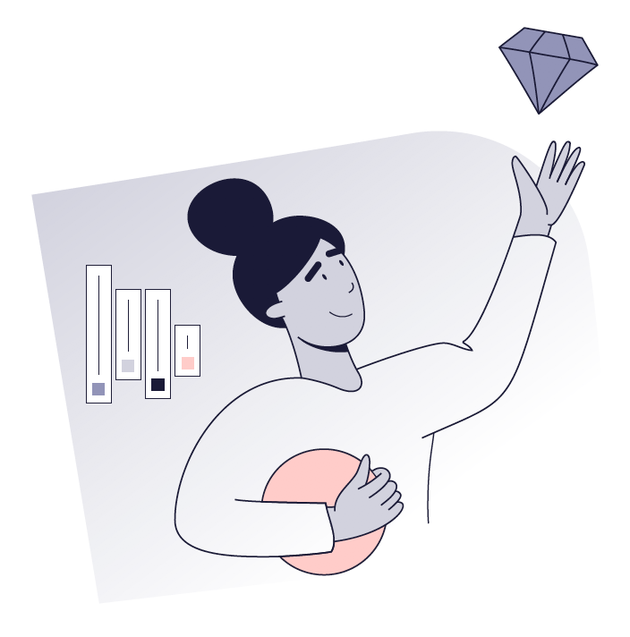
94% of employees would stay longer if their workplace invested in their career. And on top of this, employees simply expect us to manage their data in compliance with GDPR.
In other words, it is time to pay attention to Talent Management!

Slide 4

Let’s flip that around
Do we want to be GDPR compliant?
Do we want to make it easy to store, edit and control data and documents timely and with the right access levels?
Do we want our employees to perform their best and grow with us?
Do we want our employees to stay as long as possible?

Slide 5


Here’s a way for us to meet our employees’ expectations today and in the future
Talent Management system
With a digital talent management system we can gather all employee data and documents in one place. We can manage, develop and retain talents while ensuring GDPR compliant storage and management of data and documents. It allows us to easily set up deletion policies, ensuring that we keep data for the time we need to be GDPR compliant.

Slide 6
What will this do for us?

Slide 7
7
Ensure GDPR compliant management of data and documents
1
With a digital onboarding system we will be able to set up personalized and inspiring pre- and onboarding journeys that drip feed onboardees with information, training and experiences that engage them. Automated task management ensures ongoing check-ins and communication touchpoints that our new hires need.

Slide 8
Violating GDPR can cost as much as 4% of our global revenue.
4%

Slide 9
77% of candidates will not apply for a job if they feel the employer is not protecting their privacy and information.
77%

Slide 10
10
Increase employee
Performance and retention
2
With a talent management system we will be able to improve employee performance and retention by running appraisals, facilitating employee development, course administration measuring and acting on eNPS, through succession planning and more.

Slide 11
The companies best at talent management are 3.8 times more likely to develop employees to perform better and 6 times more likely to address performance issues.
3.8x

Slide 12
The companies best at talent management are 2.9 times more likely to identify and develop leaders.
2.9x

Slide 13
94% of employees would stay longer if their workplace invested in their career
94%

Slide 14
14
3
Improve our bottom line
With a talent management system we will be able to save time and money on administration. We’ll be able to lift engagement and performance through appraisals, competence management, development plans and more, which will show on our bottom line.

Slide 15
It is 2.4 times more likely that the companies best at talent management will evaluate and select the right candidates. Hence avoiding high employee replacement costs.
2.4x

Slide 16
The companies best at talent management have 2.2 times the revenue growth and 2.1 times the profit rate.
2.2x

Slide 17
To sum up
A talent management system will help us store and manage our employee data and documents in compliance with GDPR. It will enable us to facilitate employee development and by doing that increase employee satisfaction and retention. And ultimately, this will all help us improve our bottom.

Slide 18
…And there is more!

Slide 19

It’s like a digital HR assistant
Digital and automated processes
will free up internal resources
No internal IT resources needed
for daily usage
We’ll have free local support
every day from 8-17
We’ll have access to consultancy
if needed

Slide 20

And in case you wonder…
Yes,
It is 100% GDPR compliant
        We’ll always have candidate & employee consent
        We’ll have deletion policy & user management in place
        Vendor is under IT audit by external IT revisions
        We’ll have secure data storage
        Data processor agreement from vendor is our guarantee

Slide 21
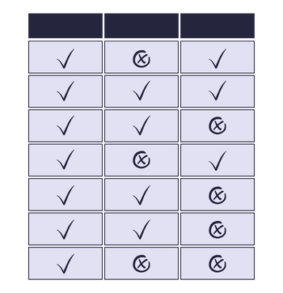
To make it even more simple, I’ve listed the system requirements we need to succeed
See overview

Slide 22
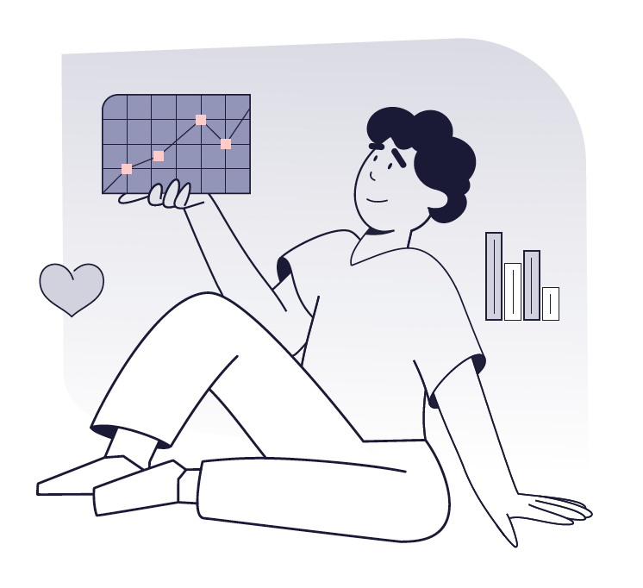
We have already stated what we want..
We want to be GDPR compliant!
We want to make it easy to store, edit and control data and documents timely and with the right access levels!
We want our employees to perform their best and grow with us!
We want our employees to stay as long as possible!

Slide 23
Let’s start complying and developing our talents
>> Let’s get started

