Slide 1
Referrals system
Your one click pitch template
>> Let’s start convince your boss

Slide 2
The hunt for talent is on
..it is getting more and more challenging to attract and recruit qualified talents.

Slide 3
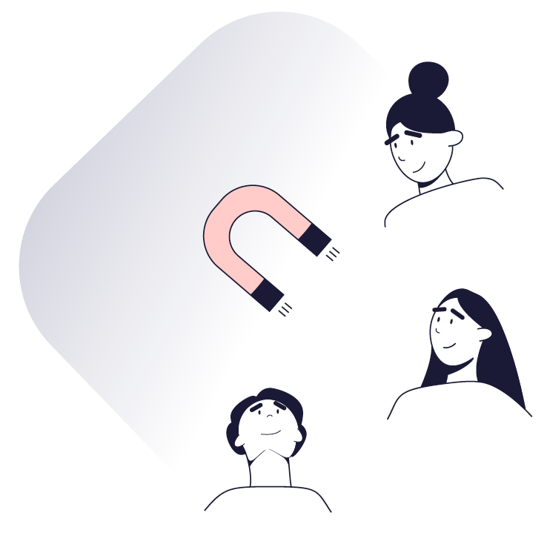
Candidates can pick and choose as they please and this makes it more expensive, time-consuming, and harder to attract candidates and ensure candidate quality.
Predictably, this affects our performance, competitive edge and ultimately our bottom line going forward.

Slide 4

Let’s flip that around
Do we want to save time and money on our recruitments?
Do we want to attract more and better candidates?
Do we want to increase the quality of our recruitments?
Do we want to be better at hiring hard-to-recruit candidates?
Do we want to recruit quickly and accurately?

Slide 5


Here’s a way for us to overcome these challenges and win the war on talent
Employee referral system
By using a dedicated employee referral system, we will use our employees’ personal networks to increase the number of qualified applications we get per position advertised.

Slide 6
What will this do for us?

Slide 7
7
1
Increase the flow and
quality of candidates
With a digital employee referral system we will experience a better inflow of candidates that are also better qualified because referees are trustworthy peers.

Slide 8
90% would look at a job description if they were recommended to a job by someone from their network.
90%
Talentech Survey, 2022

Slide 9
70% will consider a job more seriously if they are recommended to the job by someone from their network
70%
Talentech Survey, 2022

Slide 10
10
2
Shorten time-to-hire
With a digital employee referral system we will be able to speed up time-to-hire because we’ll now also reach passive candidates that take recommendations seriously.

Slide 11
It takes around 7 recommendations to find a suitable candidate, compared to the average of 118 applications, using traditional methods.
7 vs. 118

Slide 12
Using a referrals system can shorten the recruitment process by 50%
50%

Slide 13
13
3
Increase productivity
With a digital employee referral system we will see that our new hires will be more productive as they are more qualified from the outset.

Slide 14
New hires that have been recruited through a referral program are 25% more productive.
25%

Slide 15
15
4
Increase retention
With a digital employee referral system we will see that our new hires will stay longer as they feel more connected and obligated from the outset.

Slide 16
New hires that have been recruited through a referral program stay 30% longer.
30%

Slide 17
To sum up
A digital referral system will speed up our recruitments, increase quality, performance and retention of new hires, which ultimately will save us both time and money.

Slide 18
…And there is more!

Slide 19

It’s like a digital HR assistant
Digital and automated processes
will free up internal resources
No internal IT resources needed
for daily usage
We’ll have free local support
every day from 8-17
We’ll have access to consultancy
if needed

Slide 20

And in case you wonder…
Yes,
It is 100% GDPR compliant
        We’ll always have candidate & employee consent
        We’ll have deletion policy & user management in place
        Vendor is under IT audit by external IT revisions
        We’ll have secure data storage
        Data processor agreement from vendor is our guarantee

Slide 21
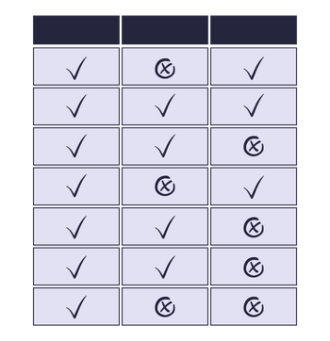
To make it even more simple, I’ve listed the system requirements we need to succeed
See overview

Slide 22
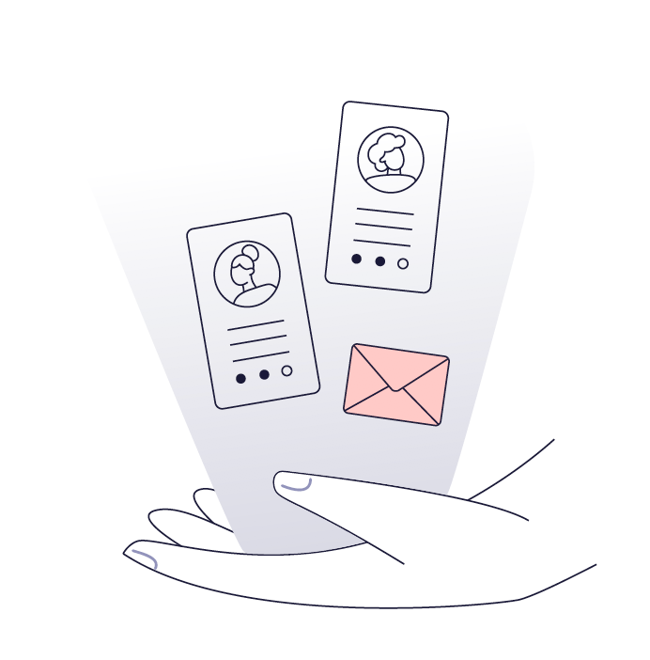
We have already stated what we want..
We want to save time and money on our recruitments!
We want to attract more and better candidates!
We want to increase the quality of our recruitments!
We want to be better at hiring hard-to-recruit candidates!
We want to recruit quickly and accurately!

Slide 23
Let’s start winning
the war on talent today!
>> Let’s get started

