Slide 1
Recruitment system
Your one click pitch template
>> Let’s start convince your boss

Slide 2
Candidates require more!
..they expect seamless digital experiences when searching and applying for jobs!

Slide 3
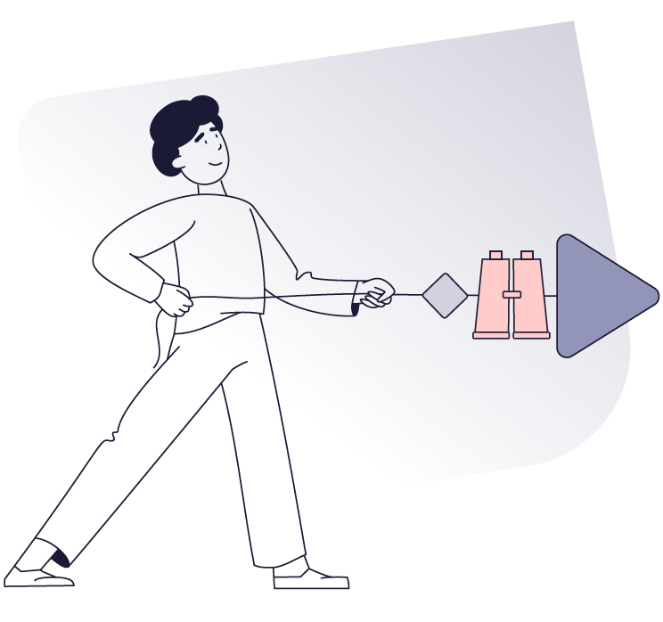
It is no surprise that candidates have the upper hand in today’s job market and expectations are rising when it comes to the user experience of searching and applying for jobs. Candidates expect fast, frictionless and unbiased recruitment processes along with ongoing communication.
And that’s not all, we are expected and required to collect, store and handle data in compliance with GDPR at all times.

Slide 4

Let’s flip that around
Do we want to meet expectations and ensure a fast, frictionless and unbiased process?
Do we want to shorten our time-to-fill and time-to-hire and increase new hire retention – saving both time and money?
Do we want to be perceived as a professional company treating candidates with respect – strengthening our employer brand?
Do we want to show our candidates and employees that their data is safe with us?

Slide 5


Here’s a way for us to meet candidate expectations in the recruitment process
Modern digital recruitment system
By using a modern digital recruitment system we’ll be able to do all things recruitment from one place. And all is done GDPR compliant, digitally, frictionless and with the candidate experience at the heart of everything.

Slide 6
What will this do for us?

Slide 7
7
Improve the candidate
experience and our
employer brand
1
With a digital recruitment system we will be able to make it easy to apply for jobs, we’ll be able to ensure transparency and communicate consistently. All with the user experience and our employer brand at heart.

Slide 8
56% of candidates who have had a bad recruitment experience will not recommend others to apply for jobs in that company.
56%

Slide 9
49% of candidates who have had a bad experience in a recruitment process will not apply for a job in the same company again.
49%

Slide 10
Research shows that investing in a good candidate experience can optimize the quality of new hires by up to 70%
70%

Slide 11
11
Professionalize
and speed up our
recruitment proces
2
With a digital recruitment system we will be able to ensure a fast and frictionless recruitment process with ongoing and partly automated communication. Internally, our process of screening and evaluating candidates will be streamlined and unbiased.

Slide 12
It takes an average of 2 months to fill a vacancy. Yet, 60% of all candidates believe it should take a maximum of 1 month from applying.
60%

Slide 13
86% say using an ATS has increased their time-to-hire while 78% say it has also improved their quality-of-hire
86%

Slide 14
94 % of HR-professionals say that using an ATS has improved their recruitment processes.
94%

Slide 15
15
Ensure a secure and
GDPR compliant
recruitment proces
3
With a digital recruitment system we’ll be able to ensure a secure and GDPR compliant recruitment process with the right legal basis for storing and managing data as well as timely deletion of data and in-system user management.

Slide 16
Violating GDPR can cost as much as 4% of our global revenue.
4%

Slide 17
77% of candidates said they wouldn’t apply for a job if they felt their privacy and information wasn’t protected
77%

Slide 18
18
4
Improve our bottom line
With a digital recruitment system we can minimize the risk of bad recruitments. Analysis tools can help us target our budget better and better candidate targeting, screening and selection tools translate into better recruitments, which again translate into better performance.

Slide 19
A bad hire can cost us in between 27.000-100.000€.
100.000€

Slide 20
78% say using an ATS has increased their quality-of-hire
86%

Slide 21
A study shows that companies most skilled at recruiting qualified employees have 3.5 times as much revenue growth and 2.0 times as much profitability.
3.5x

Slide 22
With Recruitment Analytics we can save as much as 30-40% on our job ads.
30-40%

Slide 23
To sum up
A digital recruitment system will improve the candidate experience and our employer brand. It will ensure GDPR compliance, professionalize and speed up recruitment processes. And finally, it will increase quality of hires and lead to better performance and an improved bottom line

Slide 24
…And there is more!

Slide 25
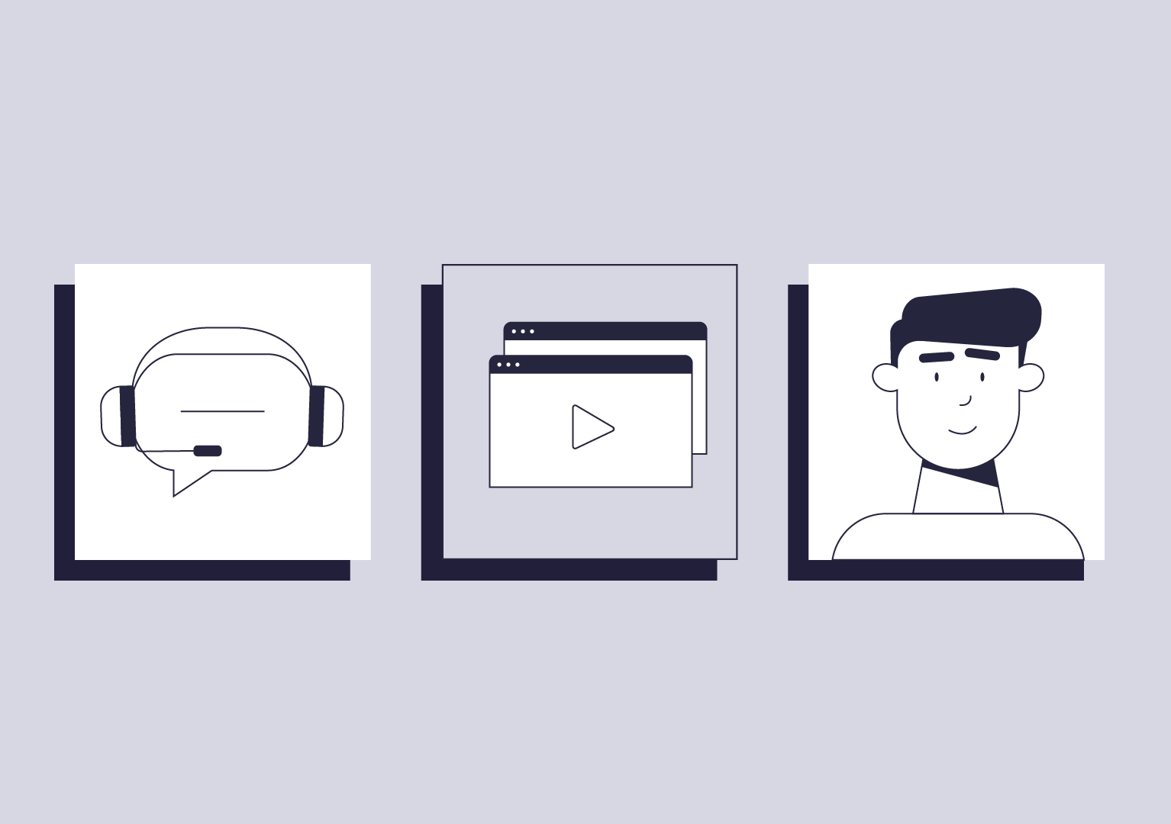
It’s like a digital HR assistant
Digital and automated processes
will free up internal resources
No internal IT resources needed
for daily usage
We’ll have free local support
every day from 8-17
We’ll have access to consultancy
if needed

Slide 26

And in case you wonder…
Yes,
It is 100% GDPR compliant
        We’ll always have candidate & employee consent
        We’ll have deletion policy & user management in place
        Vendor is under IT audit by external IT revisions
        We’ll have secure data storage
        Data processor agreement from vendor is our guarantee

Slide 27
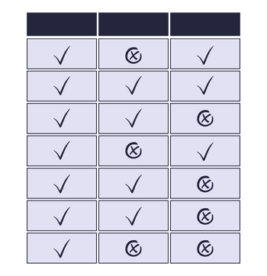
To make it even more simple, I’ve listed the system requirements we need to succeed
See overview

Slide 28

We have already stated what we want..
We want to meet expectations and ensure a fast, frictionless and unbiased process!
We want to shorten our time-to-fill and time-to-hire and increase new hire retention – saving both time and money!
We want to be perceived as a professional company treating candidates with respect – strengthening our employer brand!
We want to show our candidates and employees that their data is safe with us!

Slide 29
Let’s start meeting
candidate expectations
>> Let’s get started

