Slide 1
Employee survey system
Your one click pitch template
>> Let’s start convince your boss

Slide 2
Employees prioritize health and wellbeing over work

Slide 3

Today’s job candidates rank good work-life balance as the top factor when choosing workplace. They perform better, they are more satisfied, stay longer and are more likely to recommend their employer when it prioritizes well-being and health amongst employees.
And that is not all. By 2023 we, and all other companies, are obligated to provide and document a simple procedure for our employees to anonymously report any workplace violations.

Slide 4

Let’s flip that around
Do we want engaged employees?
Do we want high job satisfaction amongst our empoyees?
Do we want to increase employee retention?
Do we want to know of any internal challenges and be able to act in time?

Slide 5


Here’s a way for us to engage and retain out talents over time
Digital employee survey system
With a digital employee survey tool we will be able to give a voice to all our employees enabling them to express how they feel about their job situation, their manager, colleagues, the culture and more. It makes them feel heard and valued and fosters well-being.

Slide 6
What will this do for us?

Slide 7
7
1
Increase engagement and satisfaction
With a digital employee survey system we will be able to increase employee engagement and satisfaction by ensuring an open and anonymous communication channel where all employees can speak their mind about how they feel about their work situation.

Slide 8
  91% are more motivated and satisfied with their job when leadership supports well-being initiatives vs. 30 percent of those without leadership support
91%

Slide 9
74% of employees say that they are more effective when feeling heard at work.
74%

Slide 10
Engaged teams show 21% better profitability.
21%

Slide 11
11
2
Strengthen employer
brand and culture
With a digital employee survey system we’ll get insights on the psychosocial work environment every week, which will enable us to improve on things like management, culture and communication - based on facts and in time. This way we’ll be able to act proactively to improve our employer brand and work culture.

Slide 12
53% of employees are more likely to prioritize wellbeing over work.
53%

Slide 13
  89% are more likely to recommend their workplace as a good place to work vs. 17 percent without leadership support.
89%

Slide 14
14
3
Increase employee
retention
With a digital employee survey system we’ll be able to have ongoing and open communication directly with our employees and get valuable insights to proactively act on and improve our management, communication, employer brand, and work culture from, which all contribute to retaining our employees longer.

Slide 15
Engaged employees are 87% less likely to leave their employer.
87%

Slide 16
Top engaged teams show 59% less turnover
59%

Slide 17
Companies that seek regular employee feedback have turnover rates that are 14.9% lower than those that don’t.
14,9%

Slide 18
To sum up
An employee survey system will enable us to increase employee engagement and job satisfaction through ongoing feedback. We’ll be able to improve on our employer brand and work culture by gaining weekly insights to proactively improve from. Collectively, this will all enable us to increase employee retention.

Slide 19
…And there is more!

Slide 20

It’s like a digital HR assistant
Digital and automated processes
will free up internal resources
No internal IT resources needed
for daily usage
We’ll have free local support
every day from 8-17
We’ll have access to consultancy
if needed

Slide 21

And in case you wonder…
Yes,
It is 100% GDPR compliant
        We’ll always have candidate & employee consent
        We’ll have deletion policy & user management in place
        Vendor is under IT audit by external IT revisions
        We’ll have secure data storage
        Data processor agreement from vendor is our guarantee

Slide 22
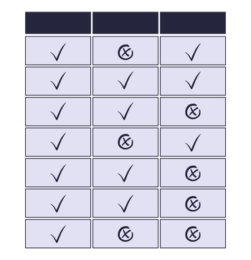
To make it even more simple, I’ve listed the system requirements we need to succeed
See overview

Slide 23

We have already stated what we want..
We want engaged employees?
We want high job satisfaction amongst our empoyees?
We want to increase employee retention?
We want to know of any internal challenges and be able to act in time?

Slide 24
Let’s start working proactively to create
real job satisfaction!
>> Let’s get started

